Slide 1
School System Management
Kimberly Guy

Slide 2
Why create this project?
Similar project was created in my previous class
School’s can use this system in order to keep track of the students and their first class as well as other information that would appear on their school record like their age, gender, and name
Lessens the chance of files getting mixed up with other files

Slide 3
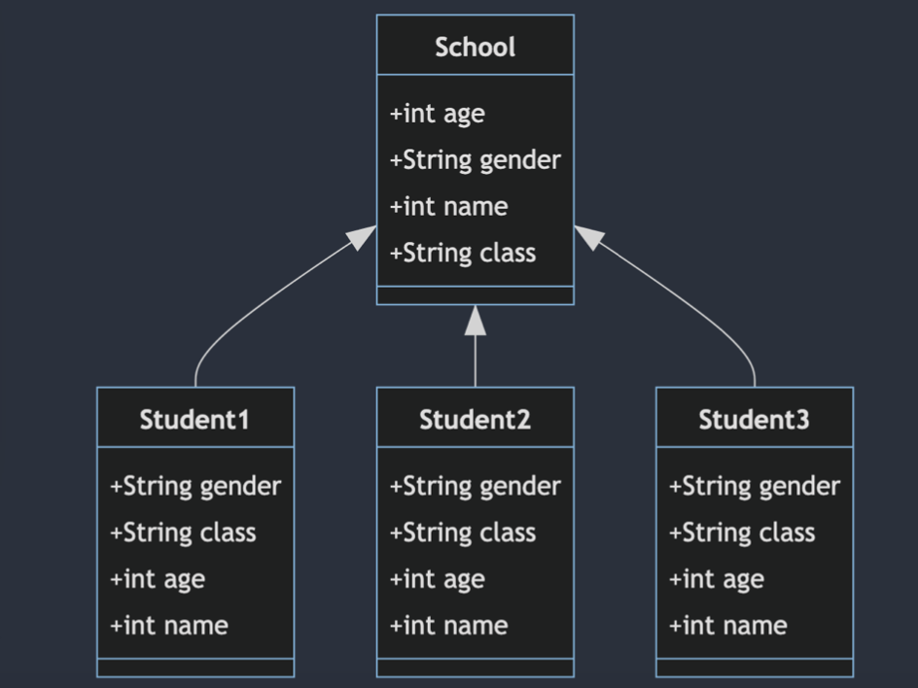
Design Process + UML
Create class and implement subclasses: name, age, gender, homeroom
UML was changed only to show what the actual system should look like with one example instead of multiple, but the class and subclasses did stay the same
Creation of the back button was newly involved

Slide 4
Conclusion
Due to complications, I was not fully able to run the code and was given that there were no errors, but this is most likely not the case, as you will be able to see in the given video.
Upside: I would ultimately believe that this system would work well in schools due to the simplicity of the matter and could be further developed in order to make a complete student file online including all classes, grades, teachers, and special notes.

Slide 5
